Slide 1
Reviewing the National Certification Programme for Cardiac Rehabilitation Background, success and lessons learnt so far?
Alexander Harrison MSc

Slide 2
A bit about myself
Biology BSc from Hull University 2013
Applied Health Research MSc from York in 2014
My thesis was on the Volume-Outcome Relationship in Cardiac Rehabilitation (CR)
Research Assistant/Research Fellow from 2014 to date
Author on 3 papers to date

Slide 3
Published Research
Observational study of the relationship between volume and outcomes using data from the National Audit of Cardiac Rehabilitation – 2015
http://openheart.bmj.com/content/2/1/e000304.full.pdf
Relationship between employment and mental health outcomes following Cardiac Rehabilitation: an observational analysis from the National Audit of Cardiac Rehabilitation – 2016
http://www.internationaljournalofcardiology.com/article/S0167-5273(16)31151-2/pdf
Does cardiac rehabilitation meet minimum standards: an observational study using UK national audit? – 2017
http://openheart.bmj.com/content/openhrt/4/1/e000519.full.pdf

Slide 4
NACR
Perform research on Cardiac Rehabilitation (CR)
Generate Annual report
Create local, commissioning and regional reports
Work with organisations that inform/guide CR

Slide 5
Organisations informing CR
NHS Digital
CCG reporting
NHS England
Best Practice Reporting
ACPICR
Research about physiotherapists
BHF
Inactivity Regional Report
BACPR
National Certification Programme for CR (NCP_CR)
Minimum Standards

Slide 6
What is the NCP_CR
Joint Programme set up in 2015 by BACPR and NACR
Aimed to assess standards being met and drive service delivery.
Minimum standards based on BACPR Core components
http://www.bacpr.com/resources/46C_BACPR_Standards_and_Core_Components_2012.pdf
Uses combination of real world data and questionnaire

Slide 7
What does NCP_CR involve
Registered and Entering NACR data
Multidisciplinary team
Delivering to priority groups
Assessment pre and post CR
Wait time from Referral to Start
Duration

Slide 8
Registered/Entering NACR data
Section 2.6 in the BACPR Core Components
“Registration and submission of data to the National Audit for Cardiac Rehabilitation (NACR)”
Additionally only way to measure other minimum standards

Slide 9
Multidisciplinary team
Section 2.2 in the BACPR Core Components
“An integrated multidisciplinary team consisting of qualified and competent practitioners, led by a clinical coordinator”
Part of the questionnaire process

Slide 10
Delivering to priority groups
Priority Groups include:
MI
MI/PCI
PCI
CABG
Heart Failure
NICE guidelines state these patients types should receive CR
NSF, CG94, CG172, CG108

Slide 11
Assessment pre and post CR
Section 2.4 in the BACPR Core Components
“Early initial assessment of individual patient needs in each of the core components, ongoing assessment and reassessment upon programme completion”
Boundary set at National Average
Assessment 1 – 76%
Assessment 2 -53%

Slide 12
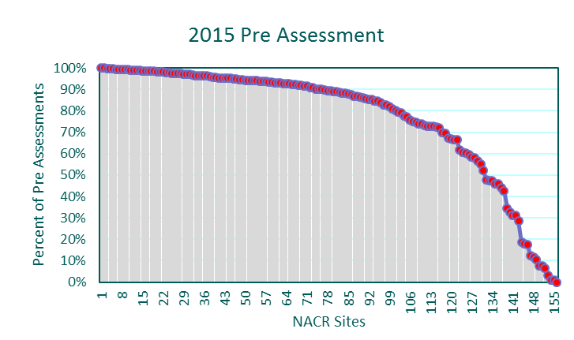
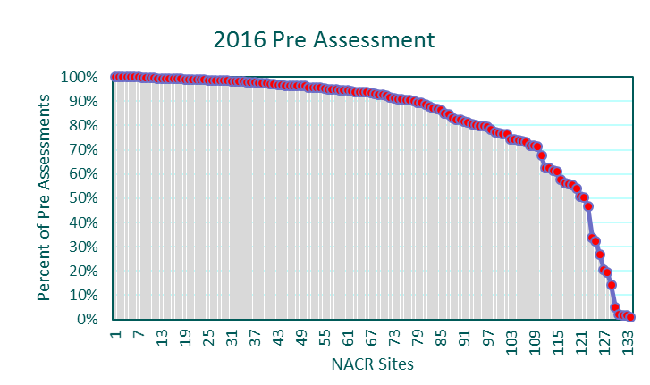
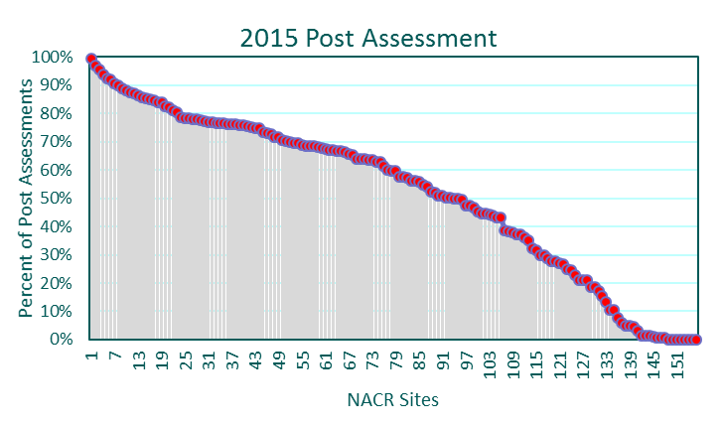
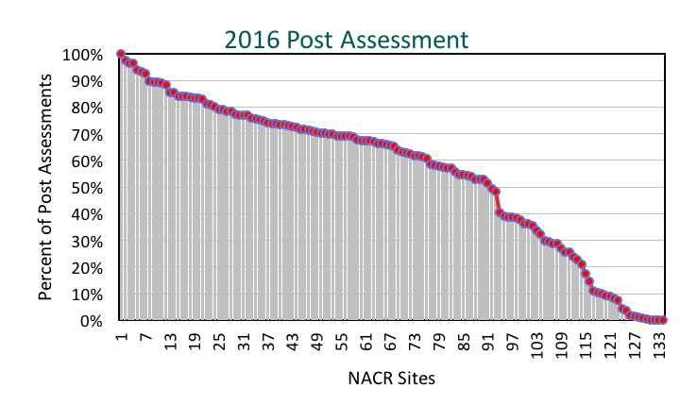
Previous Years Meeting Assessment Standard
49%
76%
56%
65%

Slide 13
Wait time from Referral to Start
Section 2.5 in the BACPR Core Components
“Early provision of a cardiac rehabilitation programme, with a defined pathway of care, which meets the core components and is aligned with patient preference and choice”
Boundary set at National Average
MI and or PCI – 38 days
CABG - 50 days

Slide 14
Duration
Cochrane review and CROS review shows variety in Duration, between 1 to 48 months
http://onlinelibrary.wiley.com/doi/10.1002/14651858.CD001800.pub3/pdf/abstract
https://www.ncbi.nlm.nih.gov/pmc/articles/PMC5119625/pdf/10.1177_2047487316671181.pdf
Standard set at 8 weeks as per CG172 absolute minimum of 56 days

Slide 15
Success So Far
312 sites in UK*
86 not entering data into NACR
226 potential based on entering data
*National Audit of Cardiac Rehabilitation Annual Report 2016

Slide 16
Success So Far
26 sites currently certified (23 programmes)
16 pilot sites
7 initial pilot sites passed in June 2015
Total of 13 pilot passed
Approximately 10 per year since
Many users willing to mentor other sites

Slide 17
Success So Far
Increased use of NACR data
Leads to improved quality
Published paper reporting NACR performance
30% high performing (6-5 standards)
46% mid level performing (3-4 standards)
24% low or failing (0-2 standards)

Slide 18
Lessons Learnt
Selling the programme
What do sites gain from certification?
What do commissioners / managers gain?
What do patients gain?
Funding for the programme
Continually driving up standards
Specifically speed of change
Duration or Dose

Slide 19
Lessons Learnt
Recertification
When does certification run out and what should recertification procedure be
Sharing information between NACR/BACPR – keeping both teams informed

Slide 20
Future Steps
Increase education
user training, conferences, newsletters
Look for funding to reduce front end cost
Continue to increase boundaries to drive service change
Bring in outcome standards
Issue with how to assess good quality

Slide 21
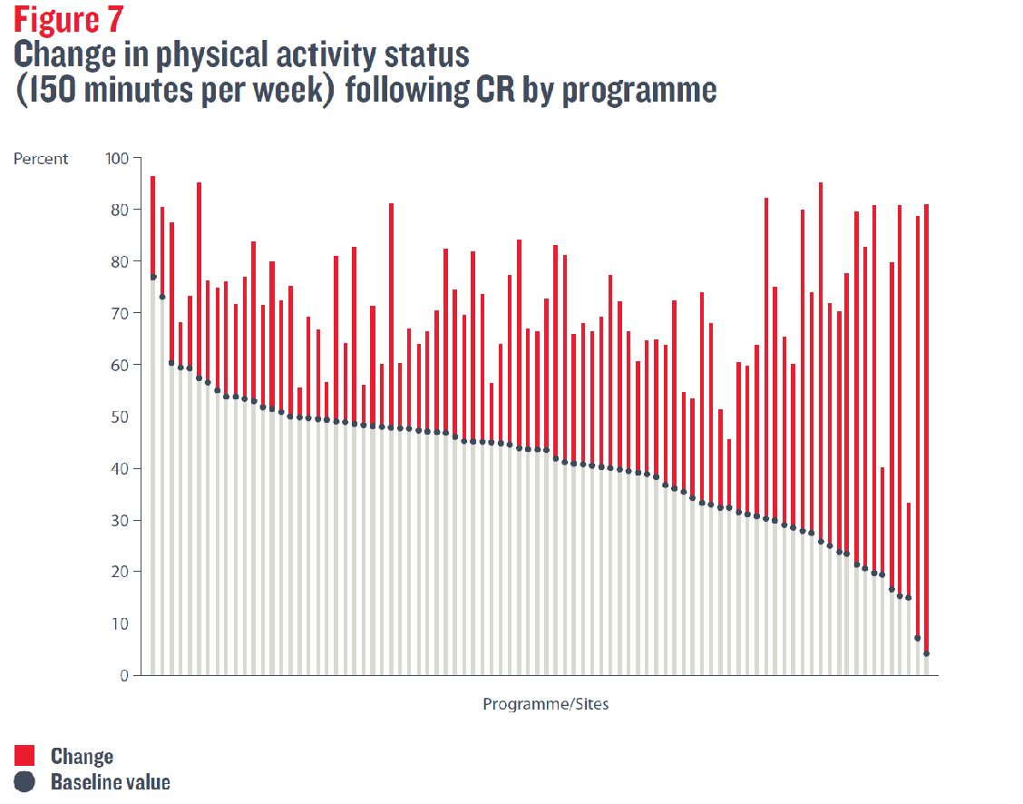
Outcome Standards

Slide 22
Outcome Standards
National Change – 30%
National post – 70%

Slide 23
Future Steps
Aim to have over 60 sites certified in next two years
Drive Standards to Gold Service
Report in annual report number meeting recommended minimum standards
Learn as we go along – early days, improve over time

Slide 24
Conclusions
NCP_CR running for over 2 years
NCP_CR slow success, but more than 10% already certified
Made up of over 5 core standards from BACPR and NACR

Slide 25
Conclusions
Current standards include, entering NACR data, Wait times and duration
The standards such as percentage assessments will continue to move with National average
Eventually bring in gold standard and outcome measures

Slide 26
Thank you for listening
Any Questions
Alexander.Harrison@york.ac.uk

